Slide 1
NLP section 2
NLP tools

Slide 2
Core & General Purpose Libraries
1- spaCy - NLP library with fast pipelines and pretrained models.
2- NLTK - research-oriented, includes tokenizers, corpora, and classic NLP algorithms.
3- Stanza - neural pipeline for tokenization, tagging, parsing, and NER.
4- TextBlob - sentiment analysis, POS tagging, and classification (built on NLTK + Pattern).

Slide 3
Code Example on Core & General Purpose Libraries

Slide 4
DL Frameworks
1- Pytorch
2- Tensorflow
3- JAX
4- Hugging Face Transformers
And much more, every other day you will see a different deep learning framework.

Slide 5
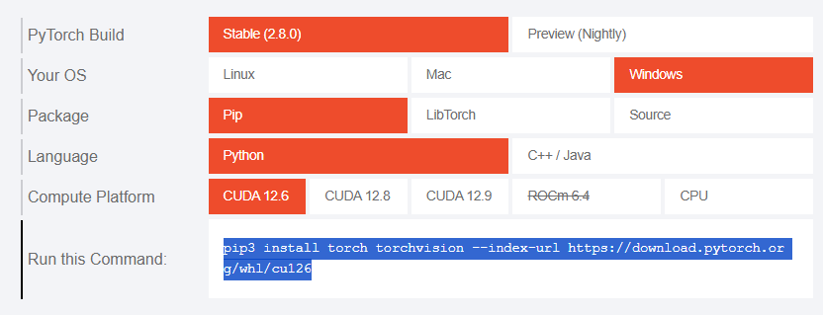
Pytorch Installation

Slide 6
What is CUDA?

Slide 7
CUDA
Developed by NVIDIA for parallel computing on GPUs.
Enables general-purpose computation (not just graphics) on GPUs.
Uses thousands of small cores to perform many calculations simultaneously.
Provides massive speedup for deep learning, scientific computing, and simulations.
Integrated with frameworks like PyTorch, TensorFlow, and Numba.
Requires an NVIDIA GPU and compatible CUDA Toolkit installation.

Slide 8
Code Example on CUDA & DL Frameworks

